Slide 1

DEC 12, 2019 PELLEGRINO NLP
Natural Language Processing
Pellegrino NLP • Dec. 12, 2019
Predicting Github Repo Languages

Slide 2



GOAL
Build a model that can predict what programming language a repository is, given the text of the README file.
The Point
HYPOTHESIS
Github READMEs are good predictors of the main programming language of a repo.
FINDINGS
Each language has key identifiers that are common ONLY to its documents.
Baseline Model is overtrained on JS.
Top 4 Model predicts very well.
Pellegrino NLP • Dec. 12, 2019

Slide 3
Our
Process
ACQUIRE DATA
PREPARE CORPUS
Beautiful Soup
Scrape Github Repos
README text
Normalize data
Top 15 Languages
EXPLORE
MODEL AND EVALUATE
Raw Counts by Language
TF by Language
TF-IDF
Baseline:
Decision Tree - 58/44
THE Model:
Top 4: Decision Tree - 82/88
Pellegrino NLP • Dec. 12, 2019

Slide 4
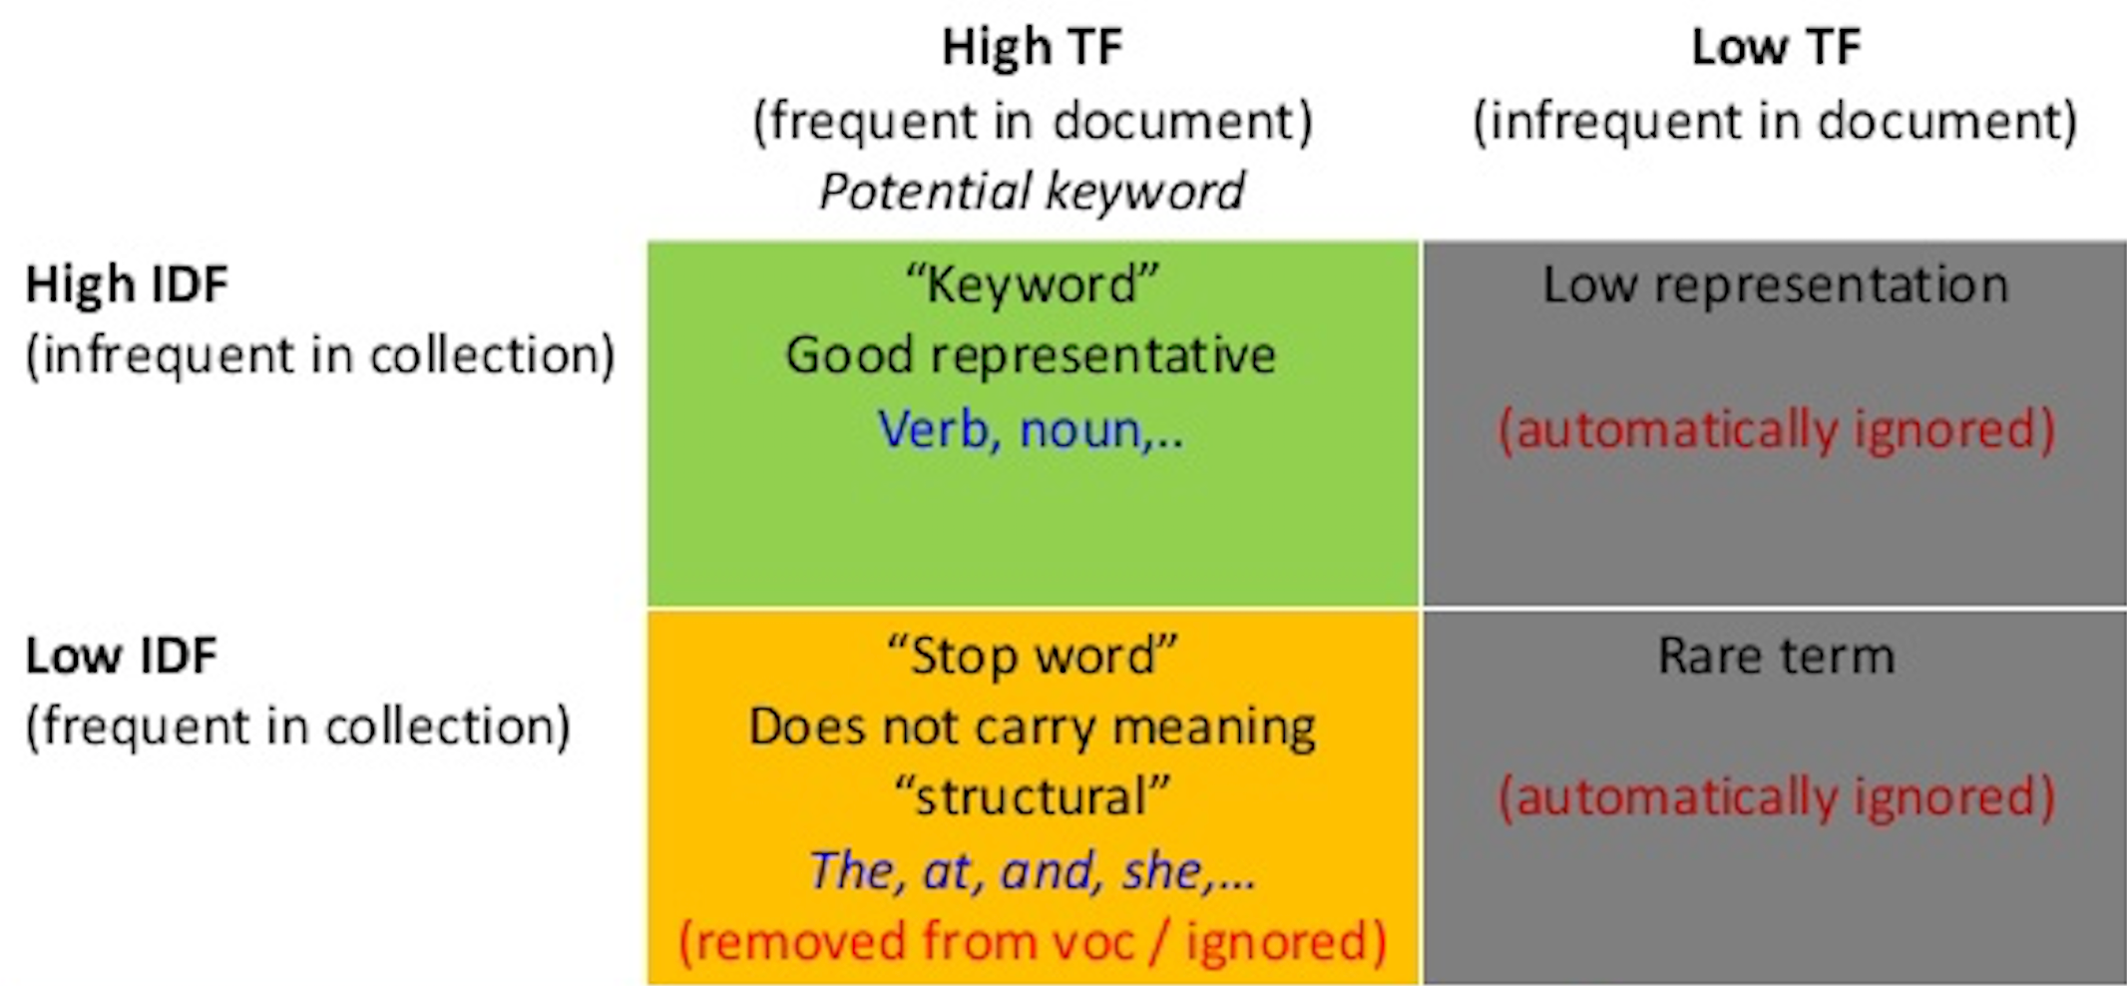

Slide 5
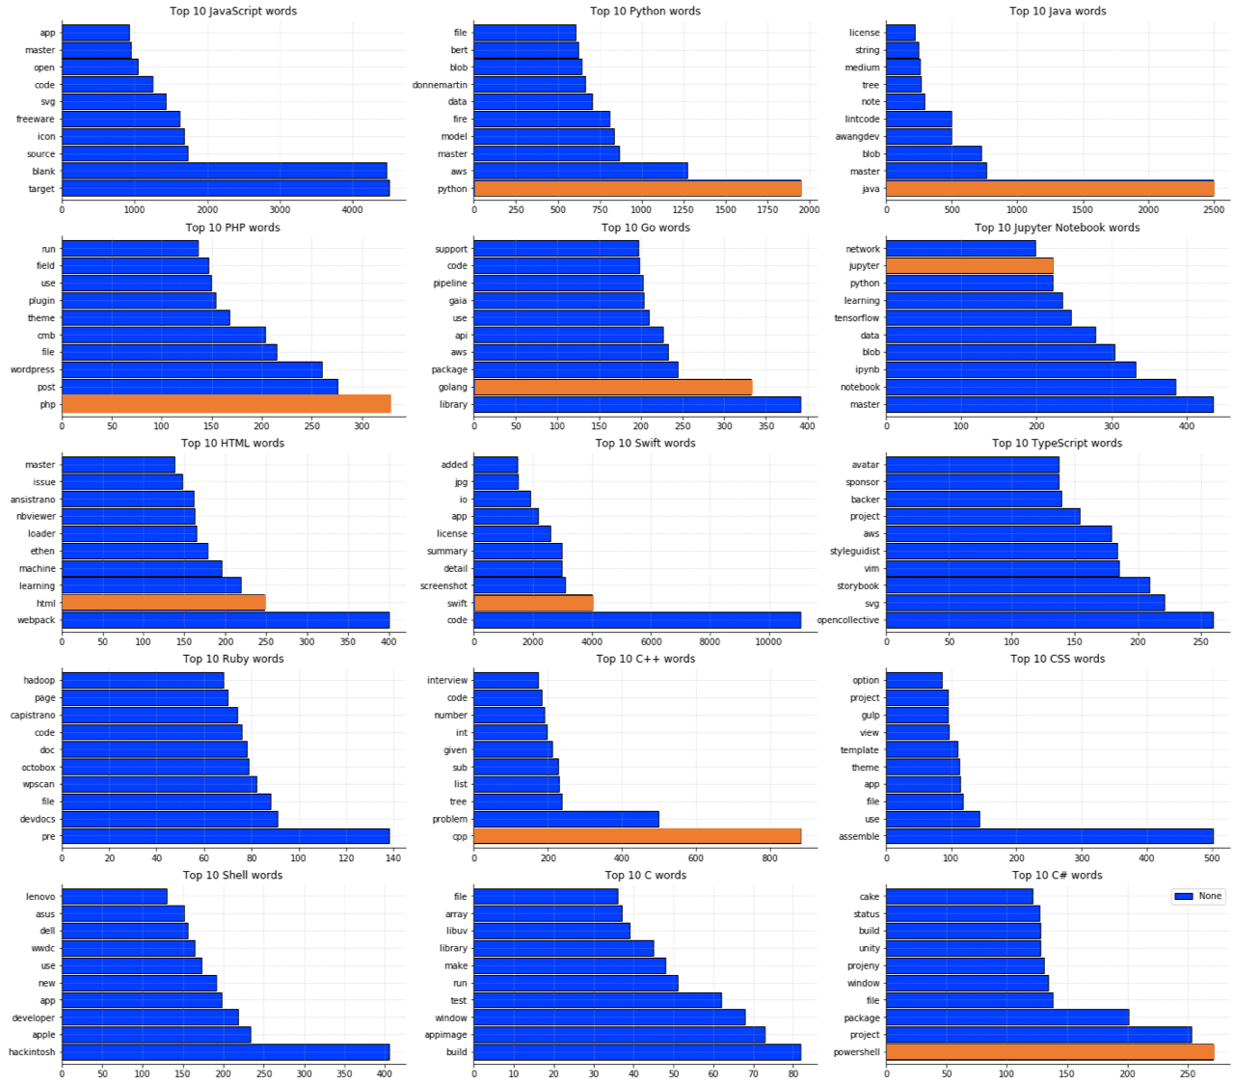
Top 10
KEYWORDS BY LANGUAGE
PELLEGRINO NLP • DEC. 12, 2019
Power Keywords should not be common across the entire Corpus but should be specific to the repos of particular programming languages.

Slide 6
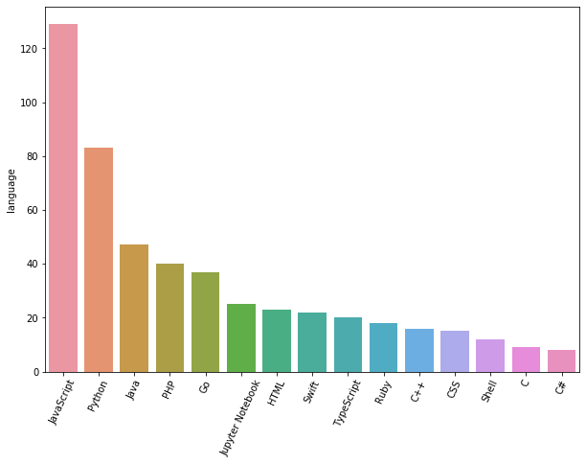
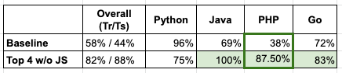
Pellegrino NLP • Dec. 12, 2019
Imbalanced Data Affects Model Performance

Slide 7
CONCLUSION
Github READMEs are good predictors of the programming languages of the repos.
Words that are unique to programming languages, including the name of the programming languages themselves, are key identifiers of the languages.
Data imbalance affects model performance, therefore you must ensure that each programming language is proportionately represented in you Corpus.
Takeaways
Pellegrino NLP • Dec. 12, 2019

